Slide 1
Health Stick

Slide 2

Hello!
We are team
ha_ha_kaha

Slide 3
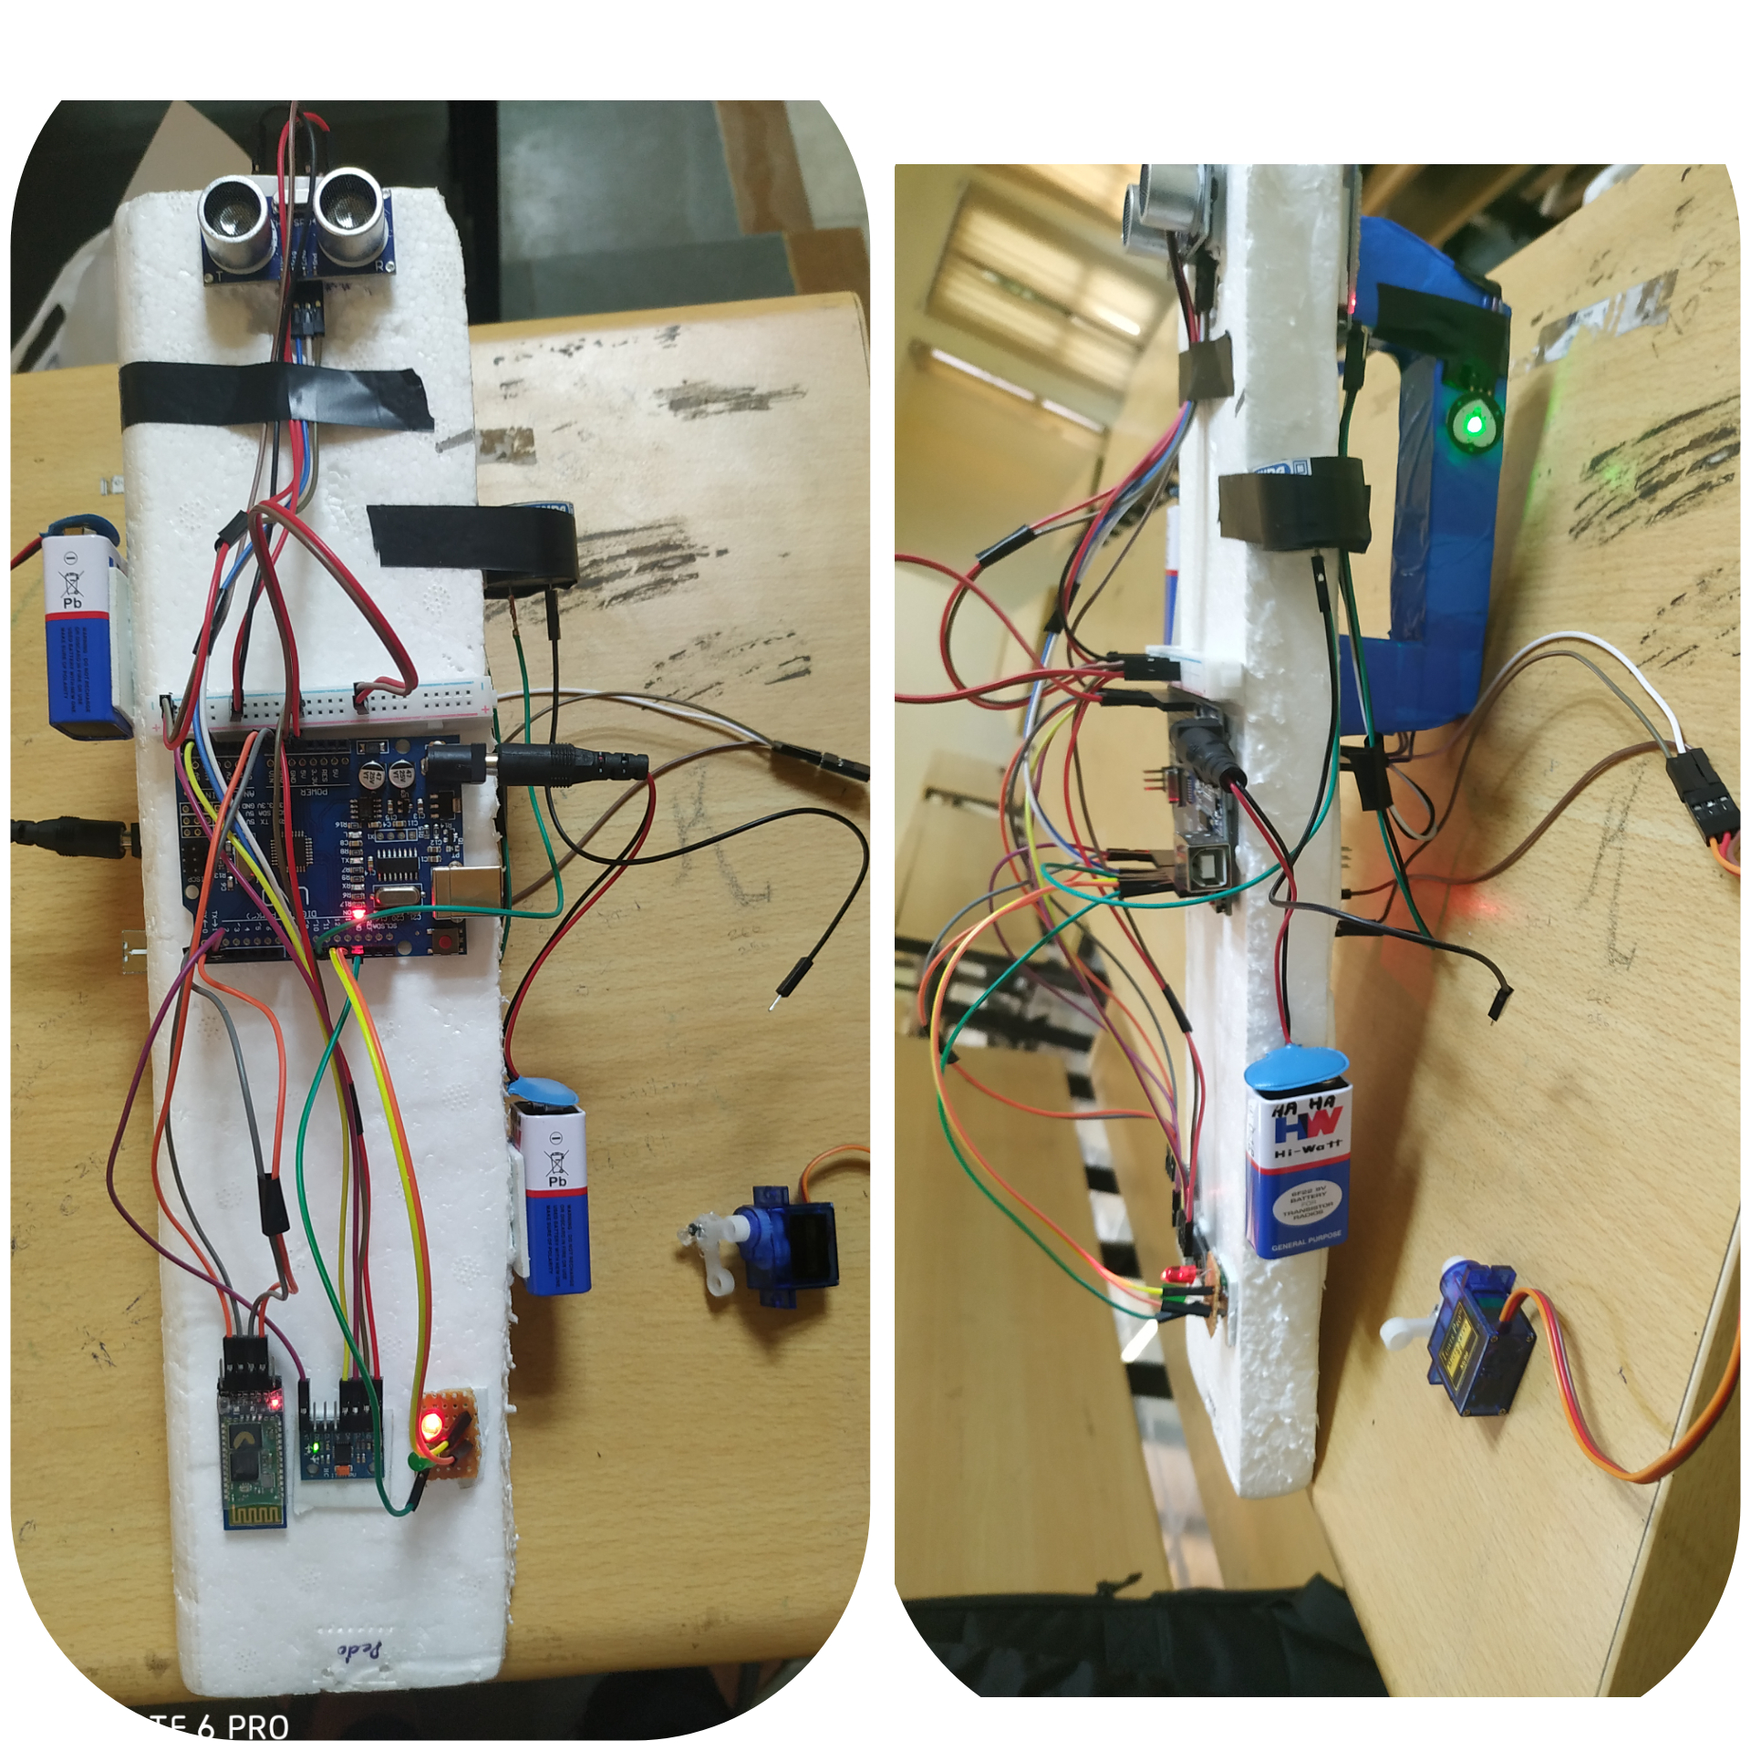
Health Stick
Health stick is a collection of several devices use for monitoring the health of a person. It consists of
Ultrasonic obstacle detector
Pedometer
Heart rate sensor
Emergency syringe (for heart sensitive patients)

Slide 4
1.
Ultrasonic Obstacle Detector

Slide 5
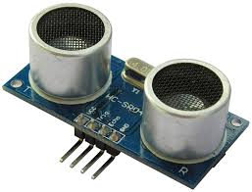
What is an ultrasonic sensor?
An ultrasonic sensor is an instrument that measures the distance to an object using ultrasonic sound waves.
An ultrasonic sensor uses a transducer to send and receive ultrasonic pulses that relay back information about an object’s proximity.
High-frequency sound waves reflect from boundaries to produce distinct echo patterns.

Slide 6
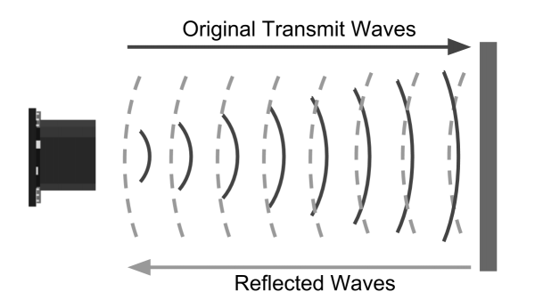
How Ultrasonic Sensors Work.
Ultrasonic sound vibrates at a frequency above the range of human hearing.
Transducers are the microphones used to receive and send the ultrasonic sound.
Our ultrasonic sensors, like many others, use a single transducer to send a pulse and to receive the echo. The sensor determines the distance to a target by measuring time lapses between the sending and receiving of the ultrasonic pulse.
The working principle of this module is simple. It sends an ultrasonic pulse out at 40kHz which travels through the air and if there is an obstacle or object, it will bounce back to the sensor. By calculating the travel time and the speed of sound, the distance can be calculated.

Slide 7
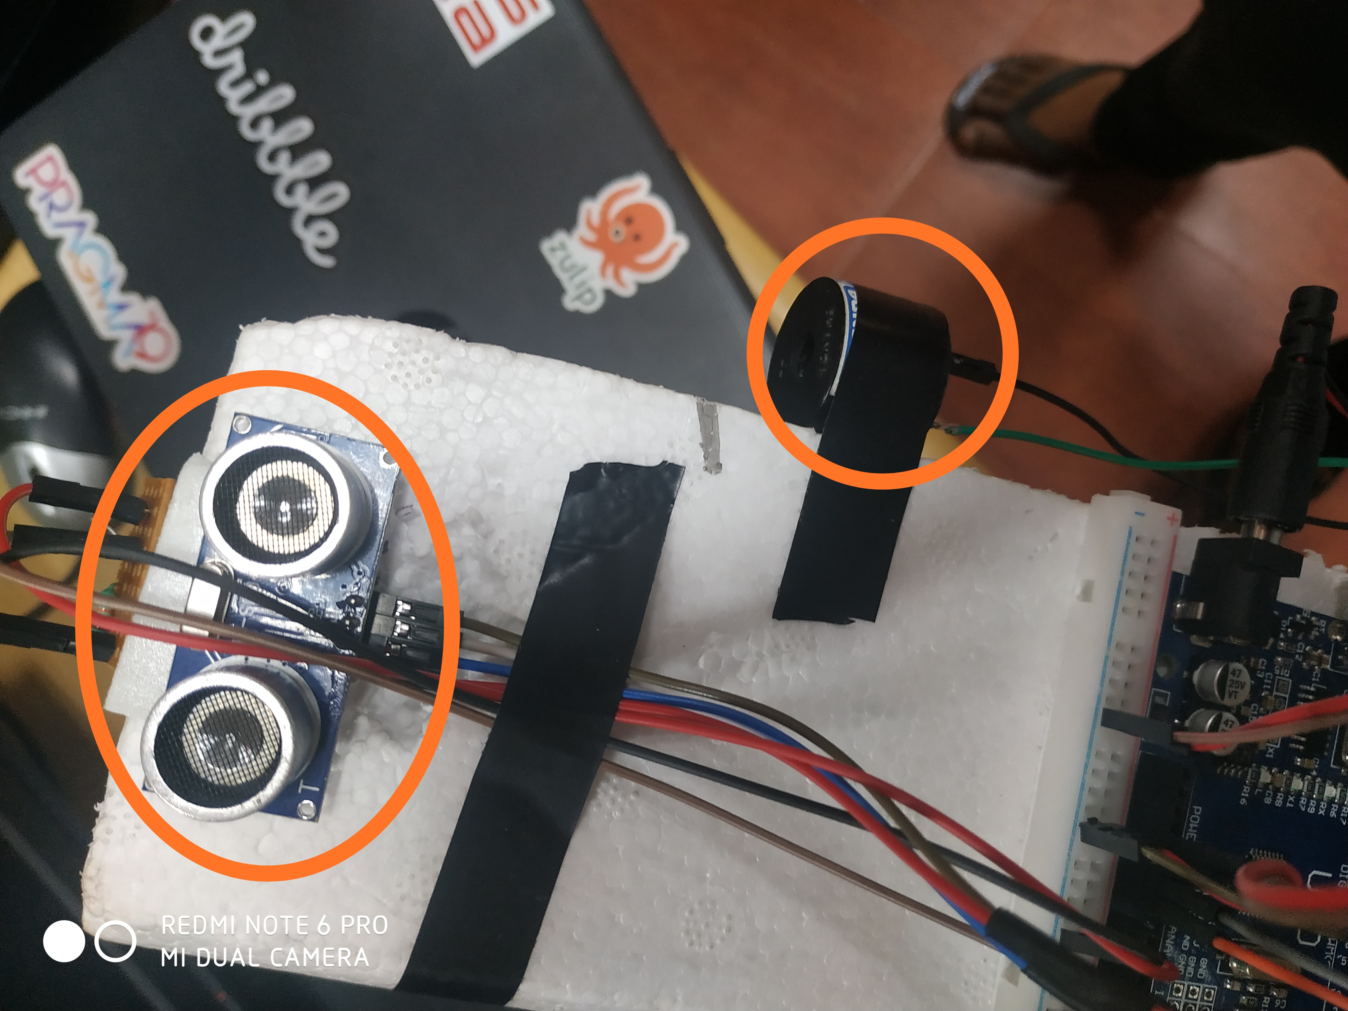

Slide 8


Slide 9
2.
Pedometer

Slide 10
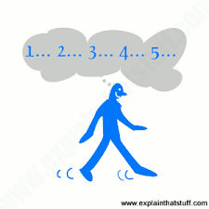
What is Pedometer
A pedometer is a small device that counts the number of steps you take. It is also called a step counter. Some pedometers also tell you how far you've walked in miles or how many calories you've burned. But mile and calorie readings are estimates and may not be accurate.

Slide 11
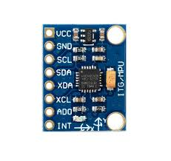
Implementation
We implemented the pedometer using accelerometer MPU6050.
By change in angle we predicts the number of steps travelled by the person.
We have also include LDR (light dependent resistor) to differentiate between outdoor and indoor steps.

Slide 12
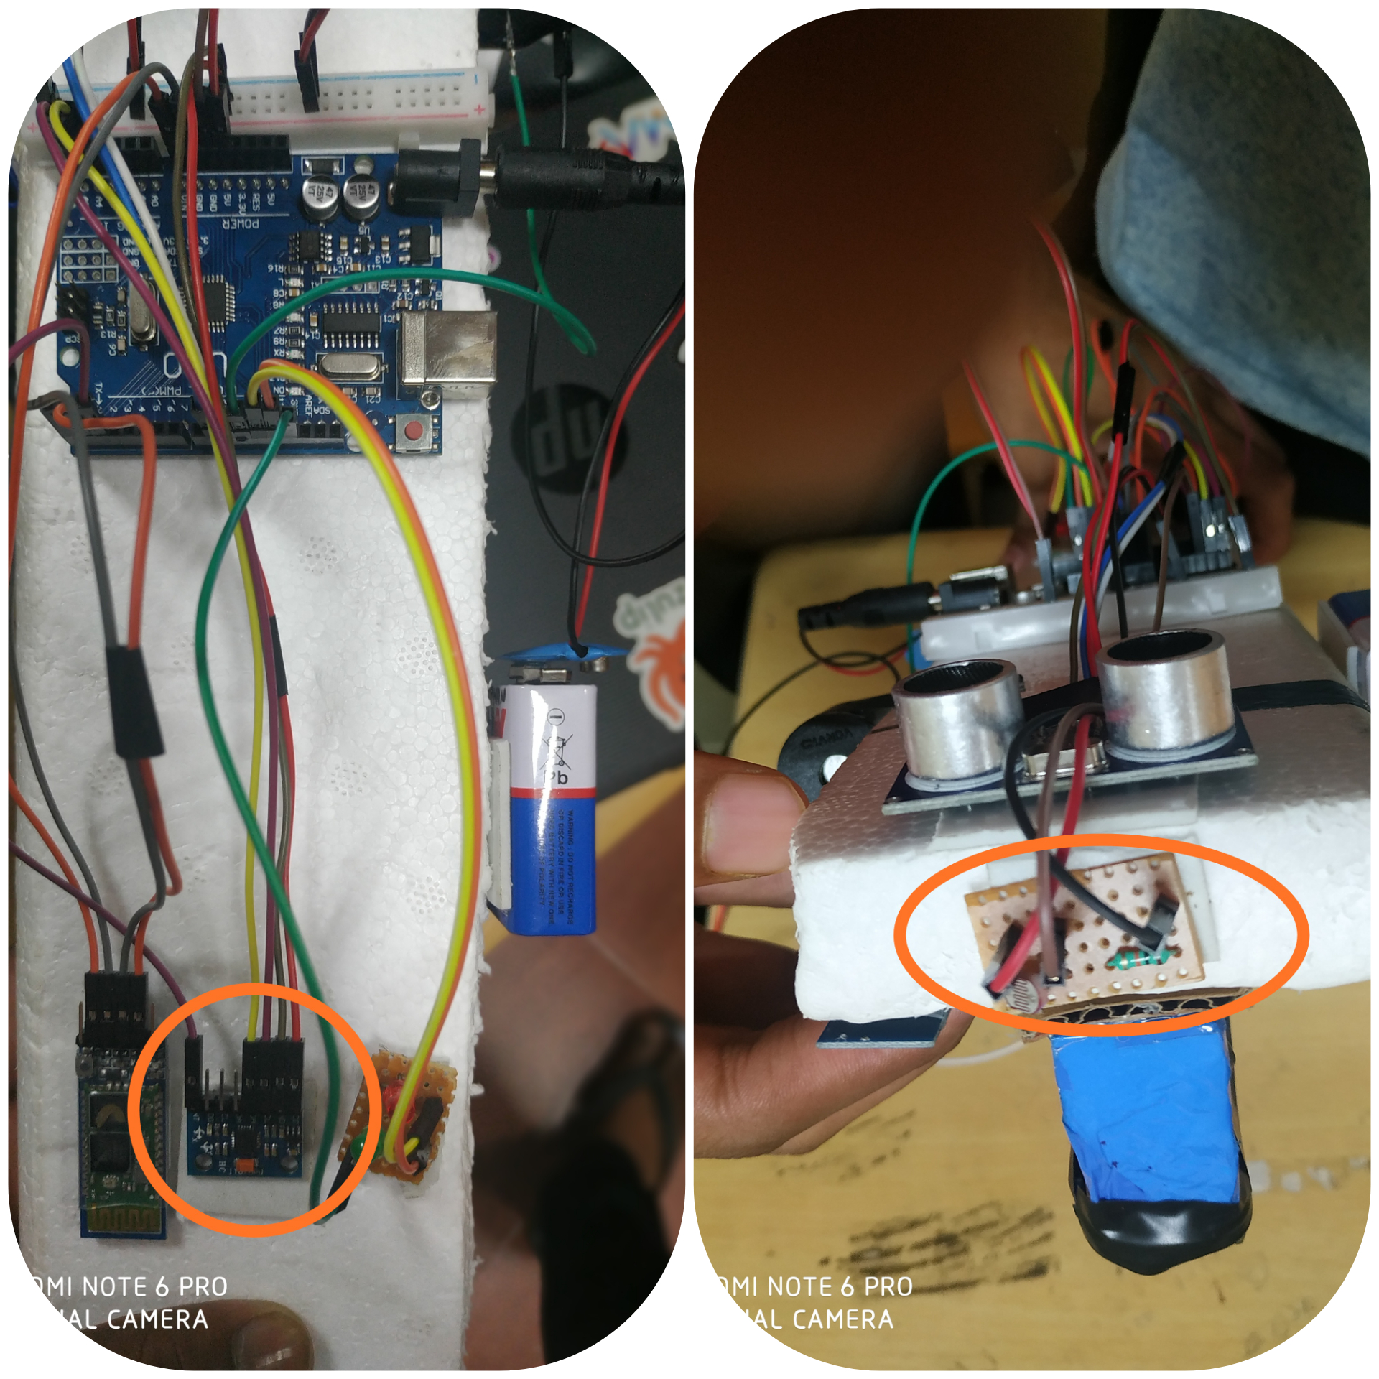

Slide 13
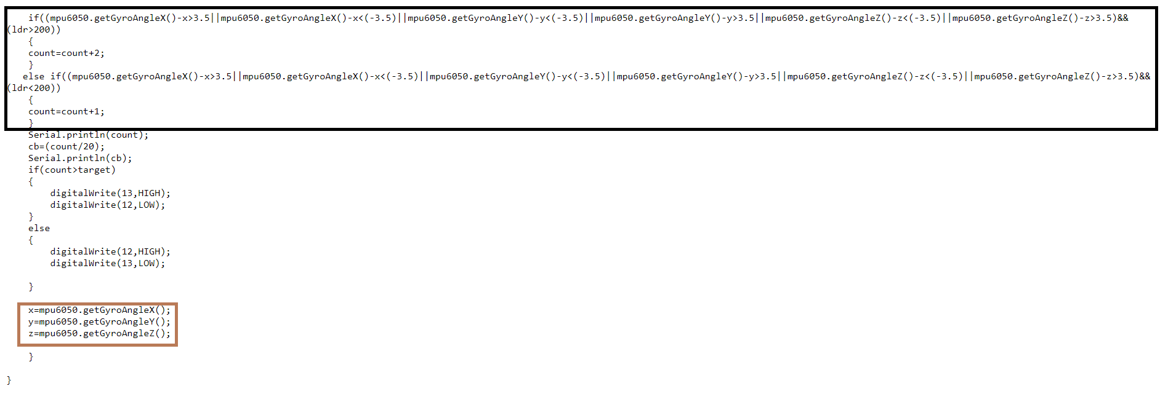

Slide 14
3. Heart rate sensor

Slide 15
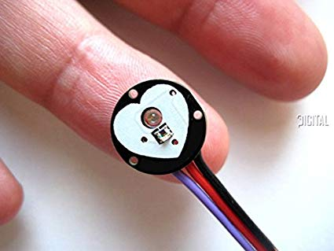
Heart Rate Sensor
The heart rate sensor measures your heart rate in Beats per Minute using an optical LED light source and an LED light sensor. The light shines through your skin, and the sensor measures the amount of light that reflects back. The light reflections will vary as blood pulses under your skin past the light.

Slide 16
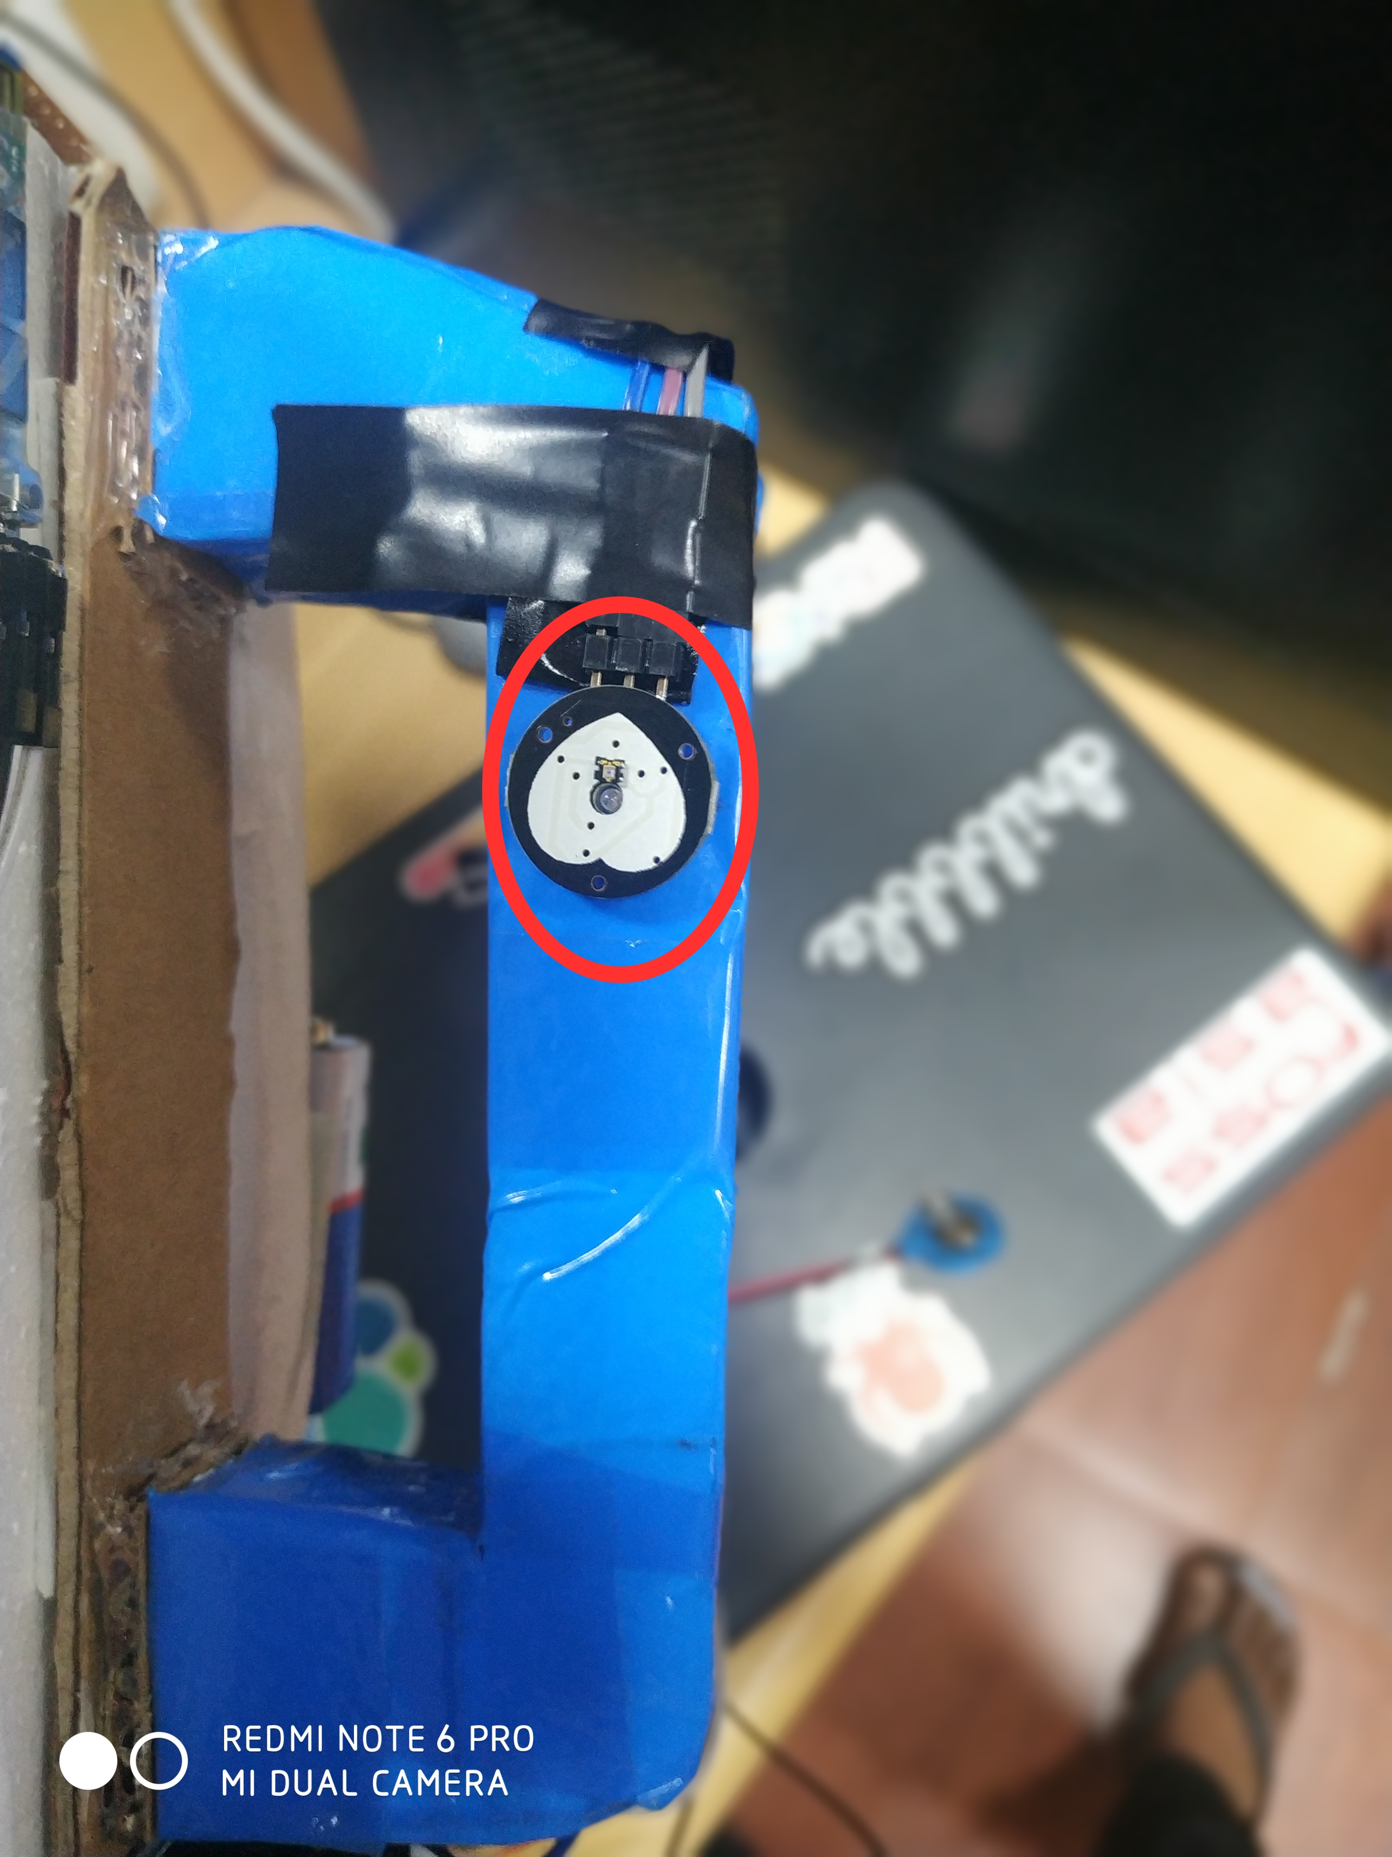

Slide 17
4.
Emergency Syringe

Slide 18
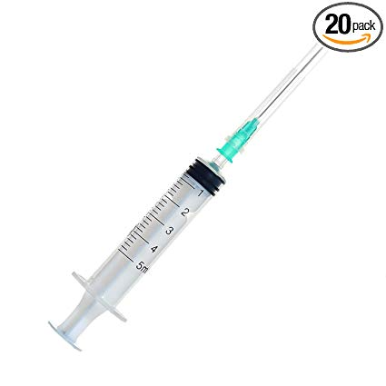
Emergency Syringe
We have include a syringe connected to servo motor. The main idea behind this syringe is to provide first aid in case of heart attack to the patient.
The servo motor receives data from the heart rate sensor. In case the heart rate is abnormal the servo motor rotates and drug is injected into the patient.
The syringe consist of a drug to stop heart attack.

Slide 19
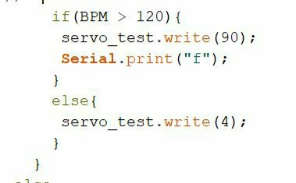

Slide 20
Bluetooth Module

Slide 21
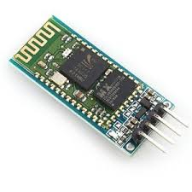
Bluetooth Module
A BlueTooth module is usually a hardware component that provides. a wireless product to work with the computer; or in some cases, the. bluetooth may be an accessory or peripheral, or a wireless headphone. or other product (such as cellphones can use.).

Slide 22
MIT app Inventor

Slide 23

MIT APP INVENTOR
We have used MIT app inventor to create an app for our health stick.
Using this app the doctor can monitor the condition of the patient.

Slide 24
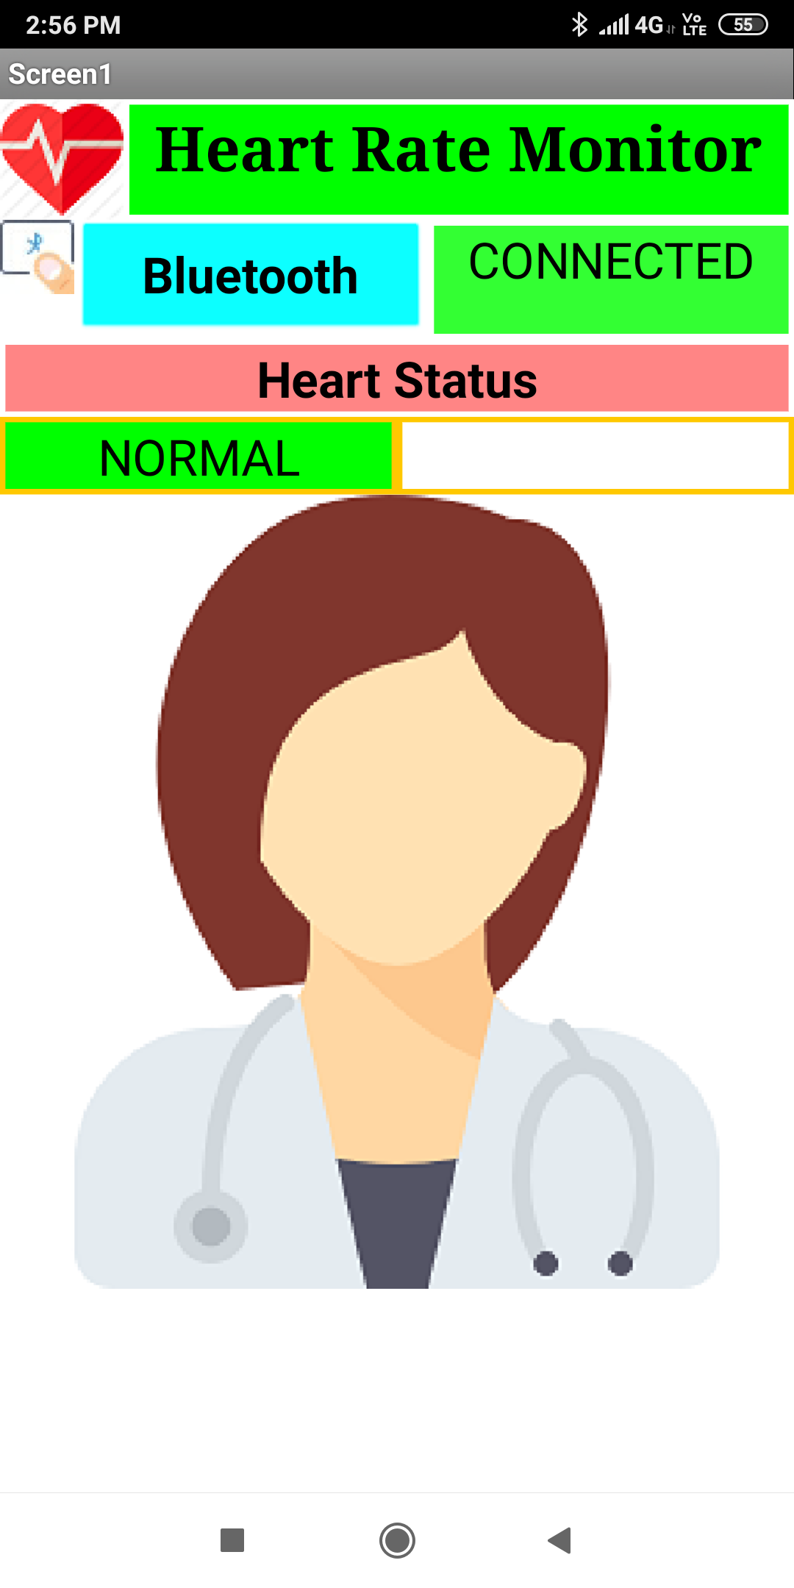
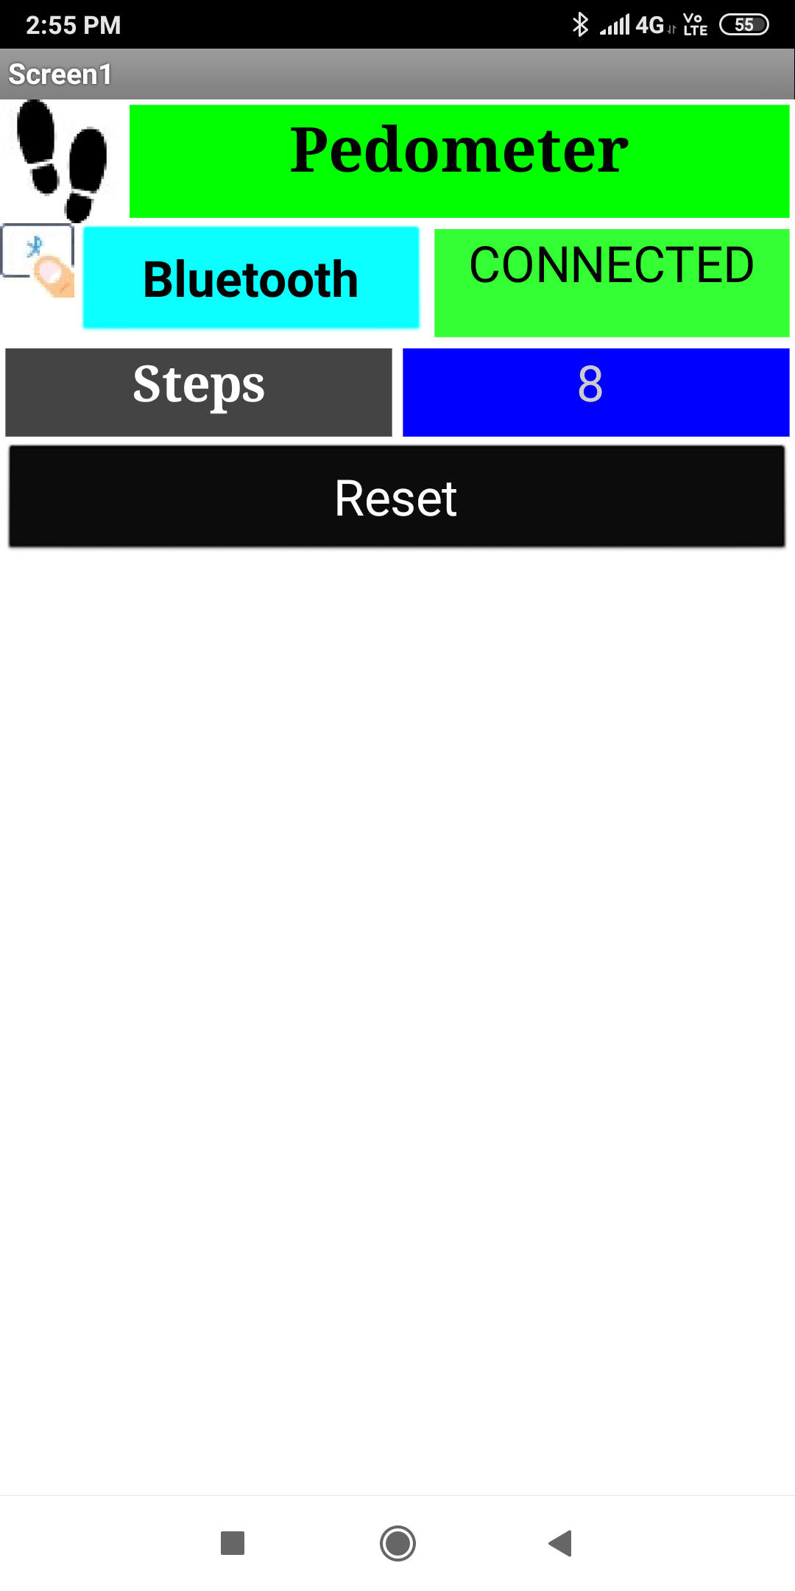


Slide 25
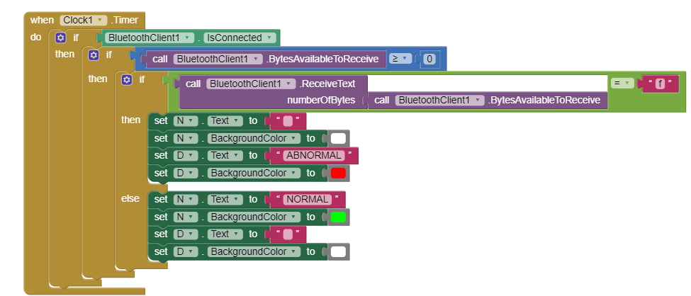

Slide 26
Thanks!

